Slide 1

Long-Run Economic Growth
Why long-run economic growth is measured as the increase in real GDP per capita, and how it varies across countries
Productivity is the key to long-run economic growth, driven by physical capital, human capital, and technological progress
Why long run growth rates differ so much among countries
Convergence hypothesis vs. divergence hypothesis
Sustainability and the challenges to growth posed by scarcity of natural resources and environmental degradation
To First
Active Learning
To Video

Slide 2
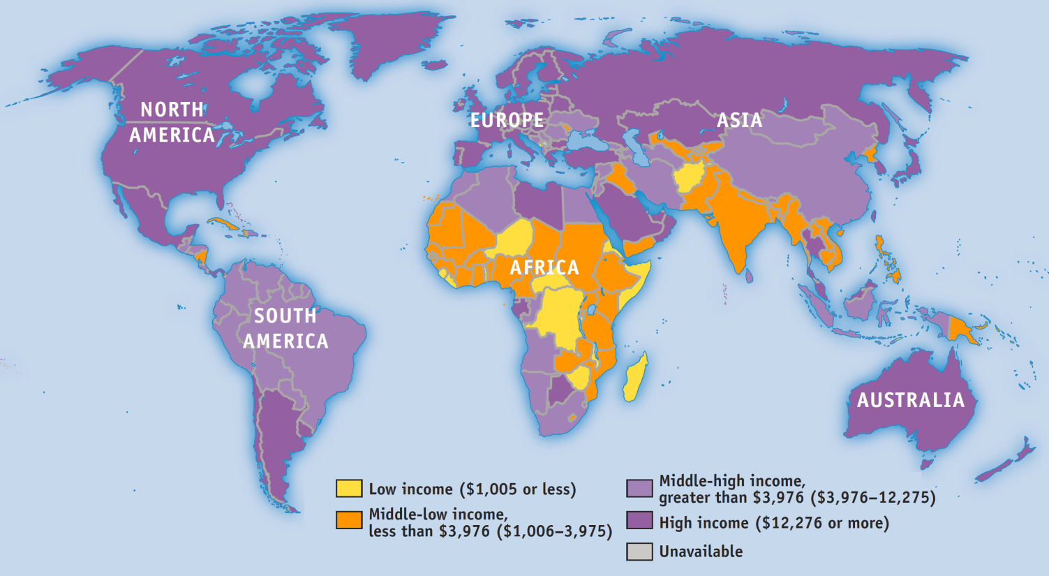
Incomes Around the World
The United States has grown quickly, while some nations have stalled.
Half the world’s population lives in countries whose standard of living is lower than the United States’ in 1900.
Source: International Monetary Fund

Slide 3
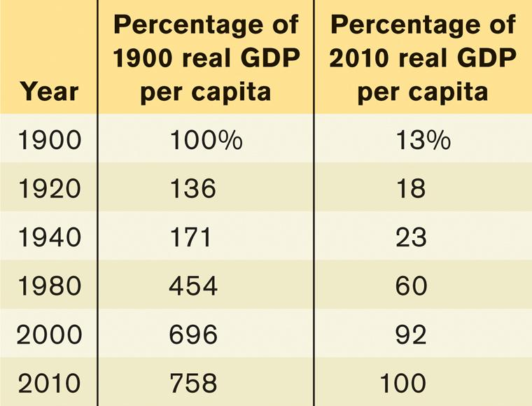
U.S. Real GDP per Capita
The U.S. economy produces more than seven times as much per person today as in 1900.
Sources: Angus Maddison, Statistics on World Population, GDP, and Per Capita GDP, 1–2008AD, http://www.ggdc.net/maddison; Bureau of Economic Analysis.

Slide 4
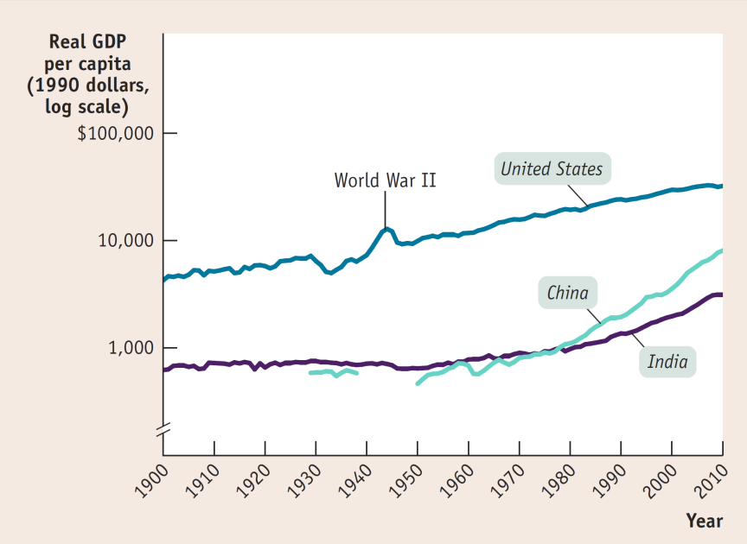
Comparing Economies Across Time and Space
Real GDP per capita (real GDP divided by the population size) is the key statistic.
Economic growth in the United States, India, and China over the past century
Sources: Angus Maddison, Statistics on World Population, GDP, and Per Capita GDP, 1–2008AD, http://www.ggdc.net/maddison; International Monetary Fund.

Slide 5
The Rule of 70: The Magic of Compounding
Even small differences in growth rates get magnified over time.
The rule of 70:
Example: If real GDP per capita is growing at an annual growth rate of 3.5%, it will double in:
The moral? Small improvements in growth add up fast (the power of compounding).

Slide 6
Compounding Growth
Growth formula: $ (1+ g)^N
g = growth (%) per year
N = how many years it grows
Examples:
India: $3,000 (1 + 0.04) ^20 = $ 6,573
China: $6,500 (1 + 0.08) ^20 = $30,296
USA: $47,000 (1 + 0.02)^20 = $62,409

Slide 7
Suppose that real GDP per capita grows at 2% per year. How many years will it take for real GDP per capita to approximately double? It will take:
70 years because of the rule of 70.
140 years, because the rule of 70 states that a variable will double in 70 years if the variable has an annual growth rate of 1%; therefore, a variable growing at 2% will take twice as long to double.
35 years, because the rule of 70 states that the number of years it takes for a variable to double is equal to 70 divided by the annual growth rate of the variable.
50 years, since at 2% per year it takes 50 years to reach 100% more than the initial real GDP per capita.
To Next
Active Learning

Slide 8
Let's figure out how long it will take for the average Indian to be as wealthy as the average Western European is today. Note that all numbers are adjusted for inflation. India's GDP per capita is $3,000, and let’s assume real output per person grows at 5% per year. Using the rule of 70, how many years will it take for India to reach Italy's current level of GDP per capita, about $24,000 per year?
42 years
14 years
28 years
12 years
To Next
Active Learning

Slide 9
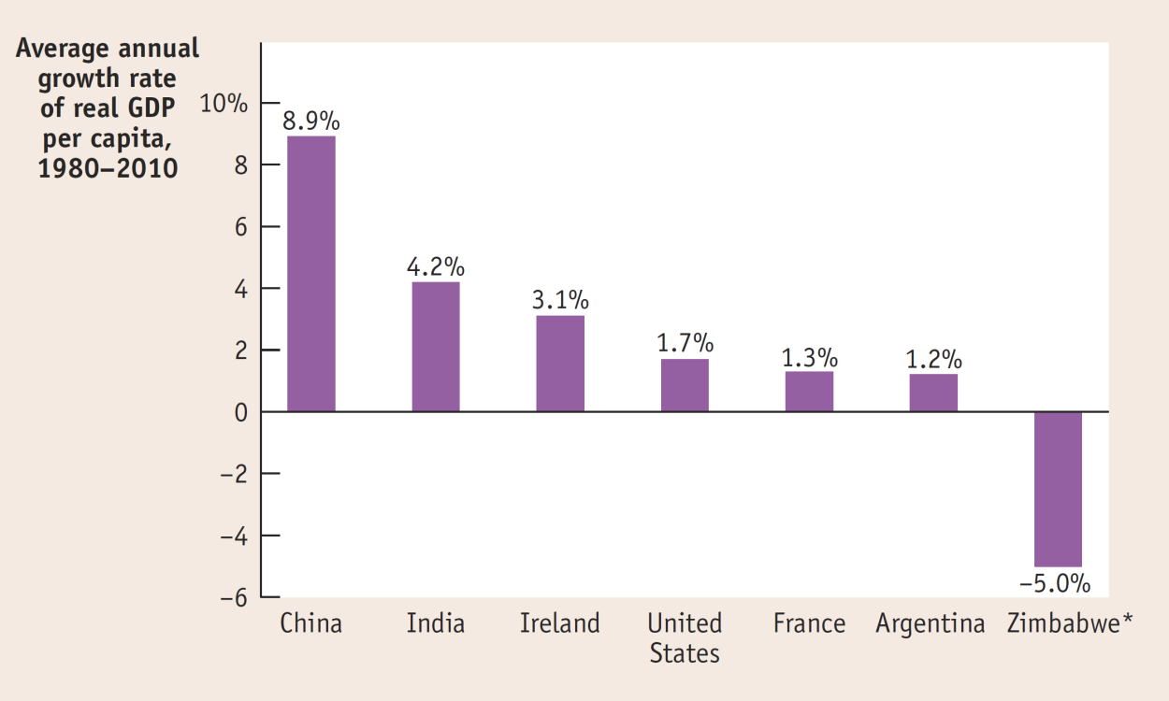
Comparing Recent Growth Rates
China, India and Ireland saw impressive growth. Zimbabwe, once the breadbasket of Africa, collapsed.

Slide 10

The Sources of Long-Run Growth
The crucial importance of productivity
Labor productivity (often referred to simply as productivity): output per worker: (Y/L)

Slide 11

Explaining Growth in Productivity
Increase in physical capital
Physical capital (K) : human-made resources, such as buildings and machines

Slide 12

Explaining Growth in Productivity
Increase in human capital
Human capital (H): the improvement in labor created by the education and knowledge embodied in the workforce.

Slide 13

Explaining Growth in Productivity
Technological progress (T) : an advance in the technical means of the production of goods and services.

Slide 14
Accounting for Growth: The Aggregate Production Function
How much does output change when we change inputs?
Aggregate production function: a hypothetical function that shows how productivity (real GDP per worker = Y/L) depends on the quantities of physical capital per worker (=K/L) and human capital per worker (=H/L) as well as the state of technology (=TFP).
Total factor productivity, TFP: Technology Progress can help elevate all the other factors, K/L and H/L, to produce more output (Y/L)
(When TFP increases, the economy can produce more output with the same quantity of physical capital, human capital, and labor.)
For instance, China and India may have a production function like this (Brookings Institution estimates):
GDP (Output) per worker= Y/L
= T × (K/L)^{0.4} × (H/L)^{0.6}
0.4 is the measure of how the physical capital per worker contributes to the growth of output per worker.
0.6 is the measure of how the Human capital per worker contributes to the growth of output per worker
In general (in the US) an estimate of 1/3 of the growth of physical capital per worker contributes to the growth of output per worker), while in China and India, the number is 0.4.

Slide 15
Log normal = Percent change
Log_{e} = Ln
(e = 2.7182718….) comes from:
X (1+ 1/x)^{x}
1 2
10 2.593
100 2.704
1,000 2.7169
…
1,000,000 2.7182718…
Why “ln x” = “% of x”
Y = ln x
dy/dx = 1/x
dy = dx/x = Δx/x = (x2-x1)/x = percent change!
We use this log to represent the % growth rate in the topic of Econ growth.
Ex:
GDP grows by 5%, and population grows by 1%; what is the growth of GDP per capita?
GDP per capita = GDP/population; since both are in %, we use the property of Log:
Log A/B = Log A - Log B
5% - 1% = 4%
Notes:
Example:
Price of a house = f { size of the house, size of the lot, number of bedrooms, number of bathrooms, distance from schools, etc. }
If you took samples of 1,000 homes in your city, and list all the prices along (y-variable) with the relevant (x-variables), and with the help of some statistical tool, you can find a correlation (positive or negative?). This is useful for prediction or estimate of home prices.
You can do the same with, let’s say, stock price.
“Ceteris Paribus”, the Latin word for “other things equal” or “hold others fixed, or constant” is an important assumption when we want to “isolate” the effect of just one x-variable to the change in y-variable. Example, if we know the “slope” between the home price (y) and the number of bathrooms (x) is approximately 500. This means, an additional bathroom will add $500 value to the home price, cet.par. (i.e. holding other variables such as distance to school, the size of the lot, as equal or unchanged). What’s (other) use of this “cet.par”? Think of a reason, or two.

Slide 16
Example of Growth Accounting
GDP per worker= Y/L = T × (K/L)^{0.4} × (H/L)^{0.6}
Using the above equation that Bosworth-Collins of Brookings Institute formulated, let’s figure out the following:
If the GDP (Y) grows by 8%,
Labor (L) grows by 1%, and
physical capital (K) grows by 3%, and
investment in human capital such as schools, training (H) grows by 2%.
TFP that contributes to the growth in Output per worker (Y/L) can be counted from:
(remember that “log” = “ % ”)
Y/L = T × (K/L)^{0.4} × (H/L)^{0.6}
(8% - 1%) = TFP + 0.4 (3% - 1%) + 0.6 (2% - 1%)

Slide 17
The Role of Government In Promoting Economic Growth
Government policies
SUBSIDIES TO INFRASTRUCTURE
Infrastructure: roads, power lines, ports, information networks, and other economic activities.
SUBSIDIES TO EDUCATION
SUBSIDIES TO R&D
MAINTAINING A WELL-FUNCTIONING FINANCIAL SYSTEM
Protection of property rights
Political stability and good governance

Slide 18

What economic growth looks like at night

Slide 19
East Asia’s Miracle
Japan, S. Korea, Taiwan, China
Very high savings rates that allow business to borrow and add more physical capital per worker.
Very good basic education has permitted a rapid improvement in human capital.
Substantial technological progress.

Slide 20
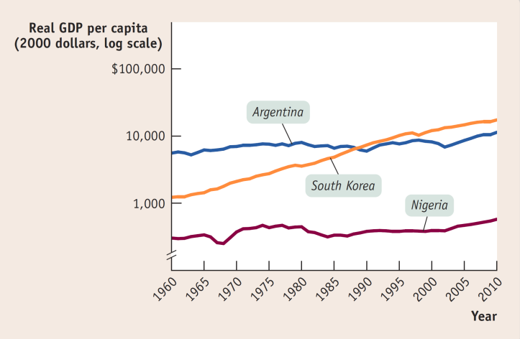
Latin America’s Disappointment
What’s holding Argentina (& other Latin Americans) back?
Irresponsible government action that eroded savings through high inflation
Lack of emphasis on education
Political instability
Source: World Bank.

Slide 21

Africa’s Troubles and Promise
What’s holding much of Africa back?
Government corruption
Civil wars & political instability
Unfavorable geography
A big question/debate:
Is Africa poor because its politics are unstable? Or vice versa?
Good news: Growth rates are up in
sub-Saharan African nations since 2011.

Slide 22
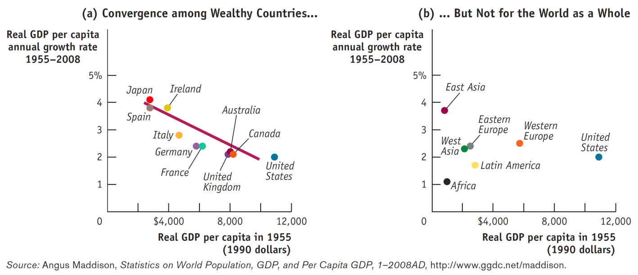
Convergence Hypothesis v. Divergence
Convergence hypothesis: international differences in real GDP per capita tend to narrow over time.

Slide 23
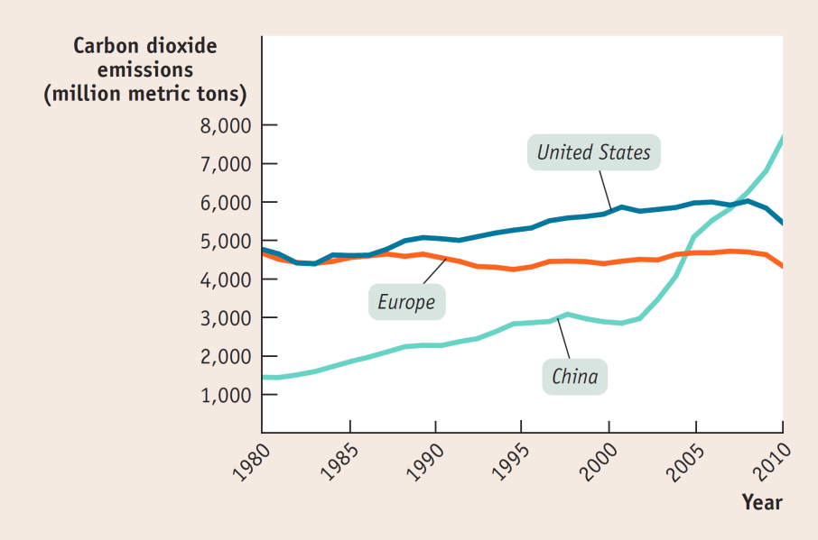
Economic Growth and the Environment
Economic growth tends to increase the human impact on the environment.
Sources: Energy Information Administration; Bureau of Economic Analysis.
Unlike resource scarcity, environmental problems don’t automatically provide incentives for changed behavior.

Slide 24
Economic Growth and the Environment
Do we have to choose?
Economic Growth v. Preserving Environment
Solutions: broad consensus, Economists prefer market-based incentives, in the form of:
carbon tax (a tax per unit of carbon emitted) or
a cap and trade system
(in which the total amount of emissions is capped and producers must buy licenses to emit greenhouse gases.)

